Slide 1

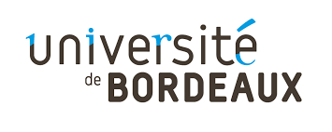
Introduction to the course
Computational Neuroscience Crash Course | July 2021
Eduarda Centeno
Monday, 5th of July

Slide 2
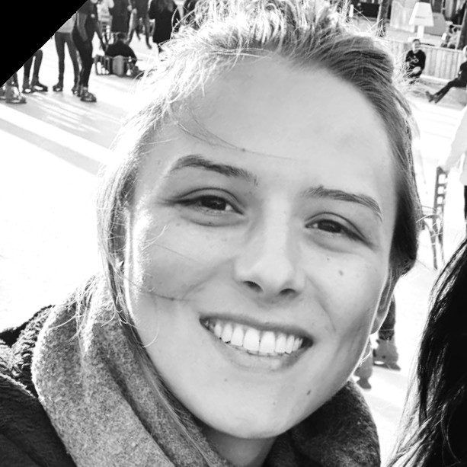
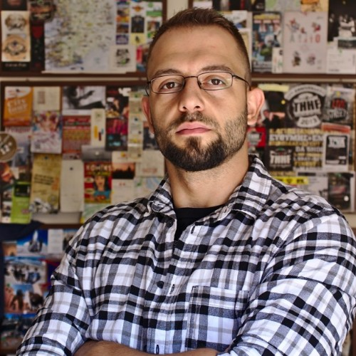
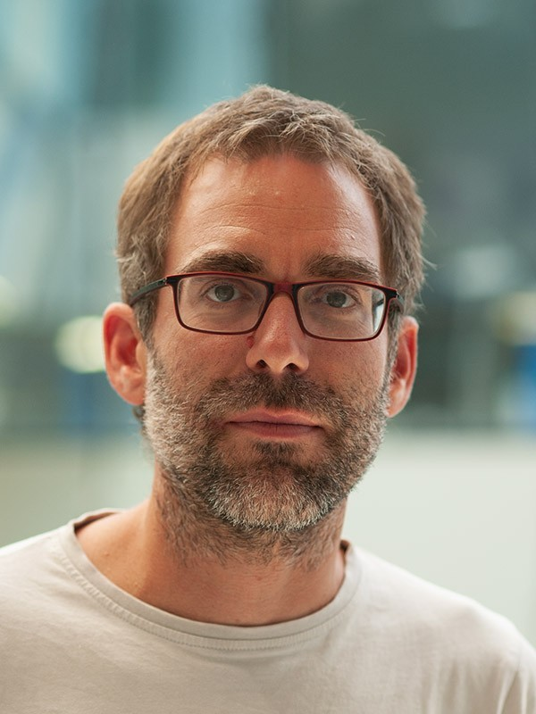
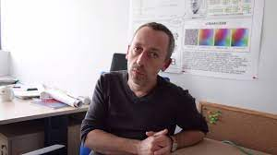
Course’s overview
The team:
Eduarda (PhD student)
Nikolaos (PhD student)
Arthur (Researcher)
Nicolas (Researcher)

Slide 3
Course’s overview
Week-long course (approx. 6:30h per day)
We start each day with a Q&A / Recap (approx. 30 min)
We will provide you with some math and programming (Python) revision
You have predefined tasks per day
You will be divided in pairs (pair programming)
We provide the tasks’ solutions by the end of each day
On Friday you will be expected to produce a final report

Slide 4
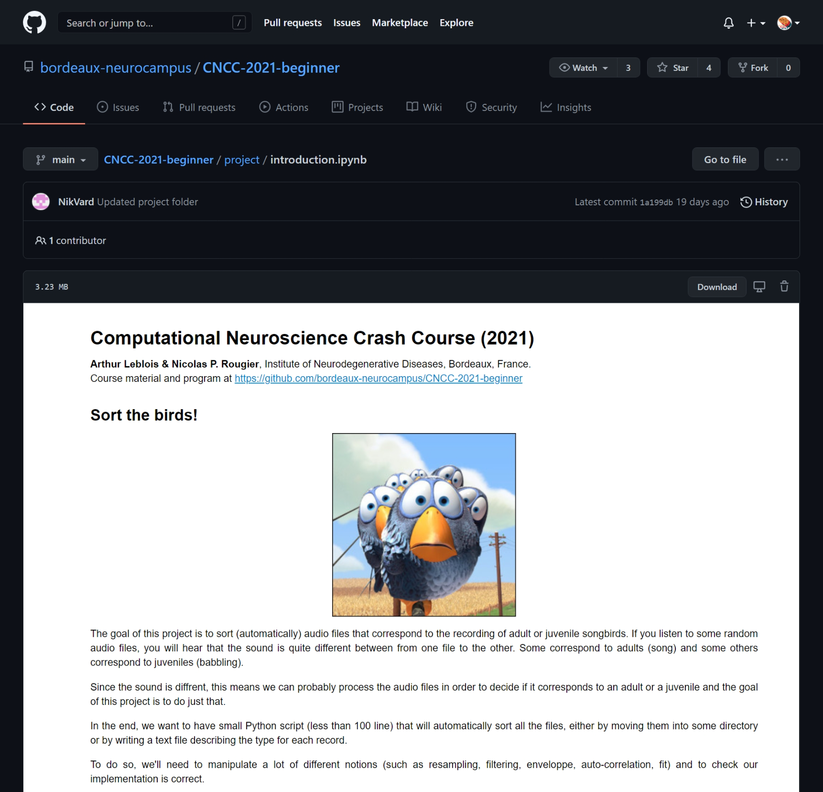
Course’s overview

Slide 5
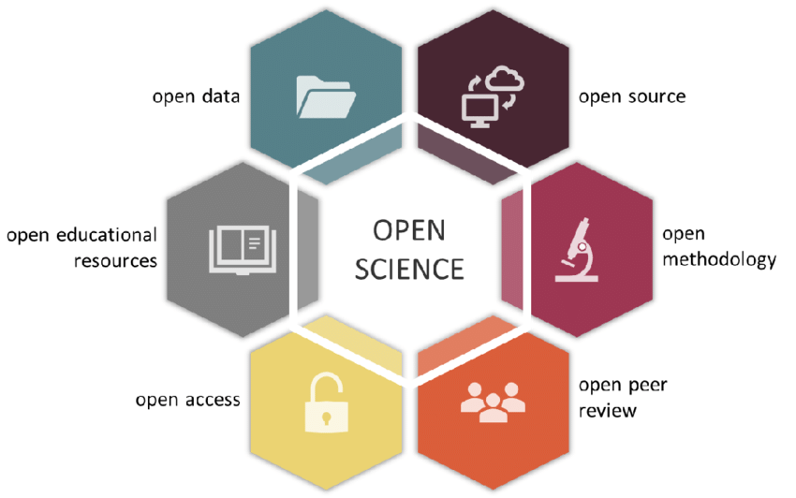
Open Science
DOI: 10.32942/osf.io/kac45

Slide 6
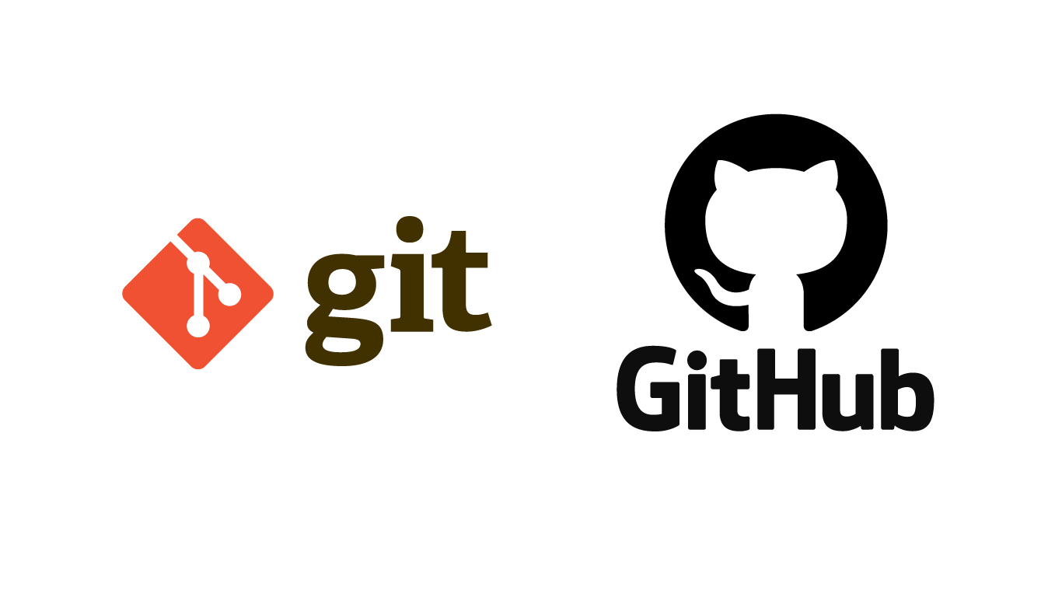

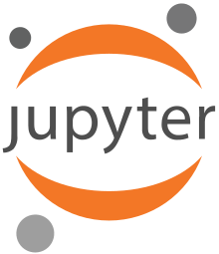
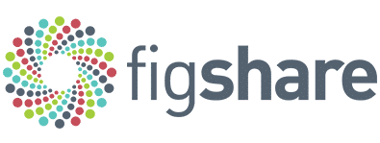

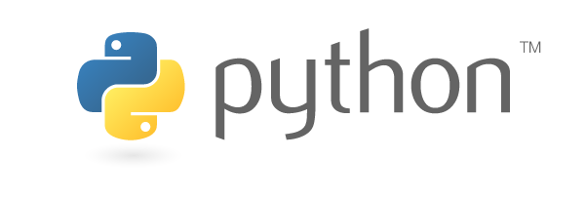
Open Science

Slide 7
Python & Anaconda: What are they?
An open-source high-level general-purpose programming language.
A distribution for Python (and R) that simplifies package management and deployment.

Slide 8
Git & GitHub: What are they?
An open-source version control system that allows you to…
Record changes to repositories/files over time
Rewind to any previous version of your files
Easily collaborate with other programmers
A cloud-based (user-friendly) website that allows you to…
Host your git repositories/projects
Easily share your git repositories/projects
Create a social network between collaborators

Slide 9
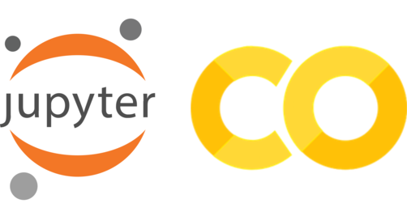
Jupyter notebooks: What are they?
“Open-source web application that allows you to create and share documents that contain live code, equations, visualizations and narrative text.”

Slide 10
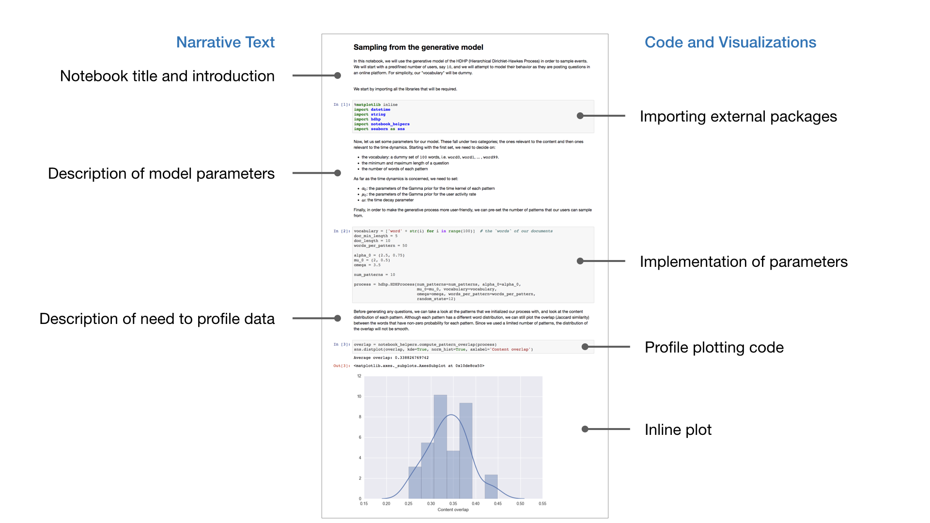

Slide 11
Figshare: What is it?
“An online open-access repository where researchers can preserve and share their research outputs (figures, datasets, images, and videos). It is free to upload content and free to access, in adherence to the principle of open data.” (Wikipedia)

Slide 12
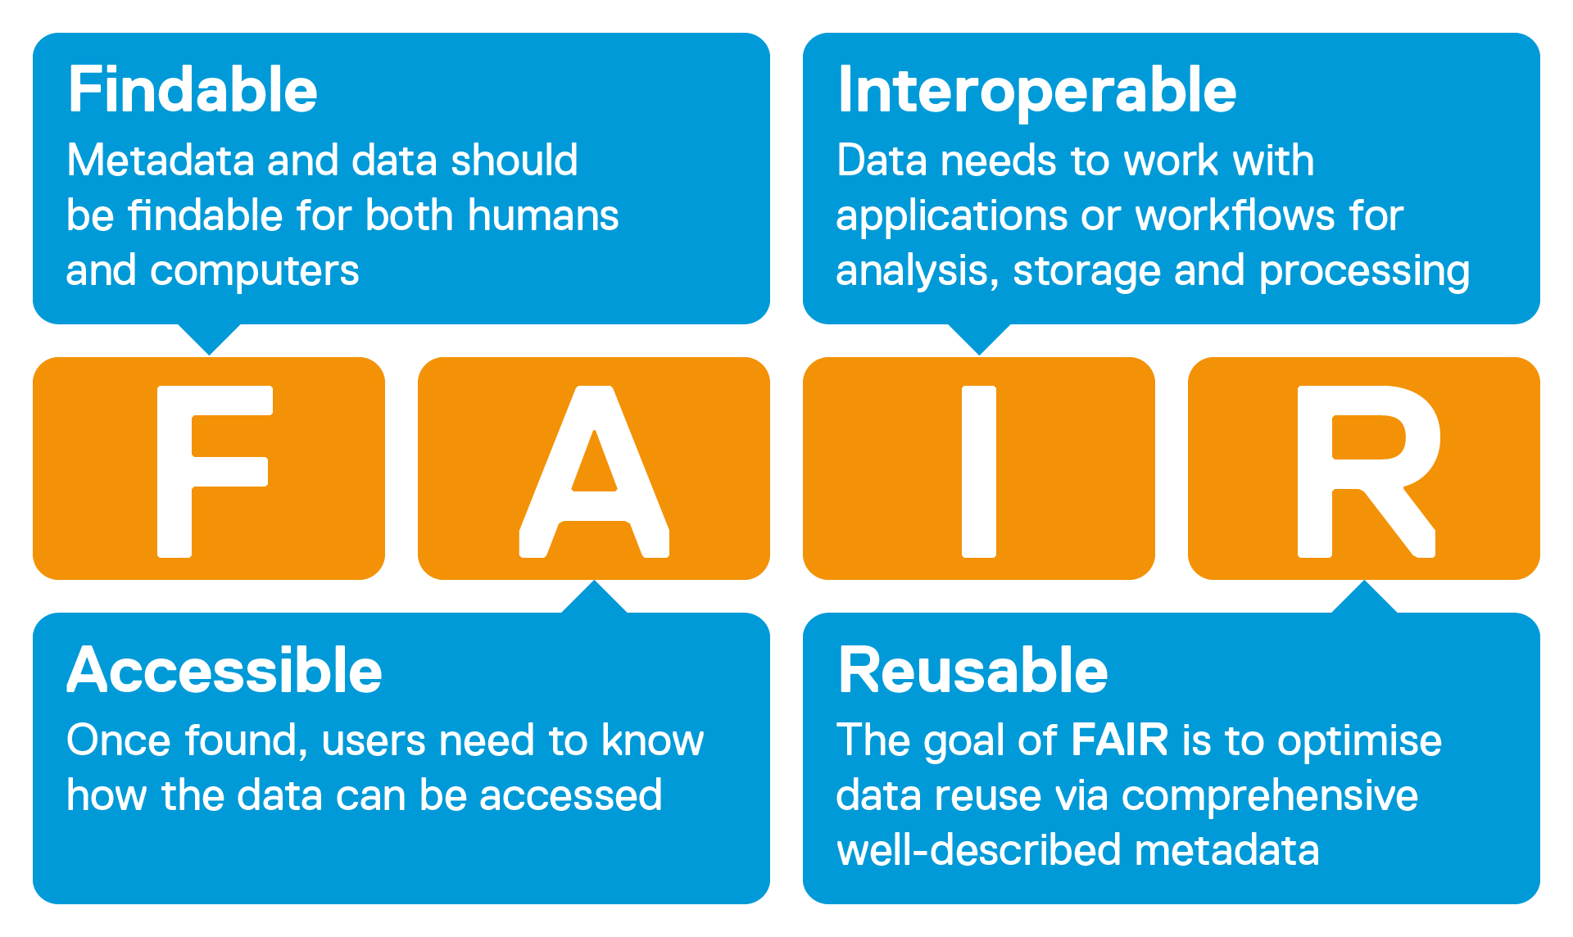
The FAIR principles: What are they?

Slide 13
More info about the course:
https://github.com/bordeaux-neurocampus/CNCC-2021-beginner
* PhD students can validate this course as part of training hours

Slide 14
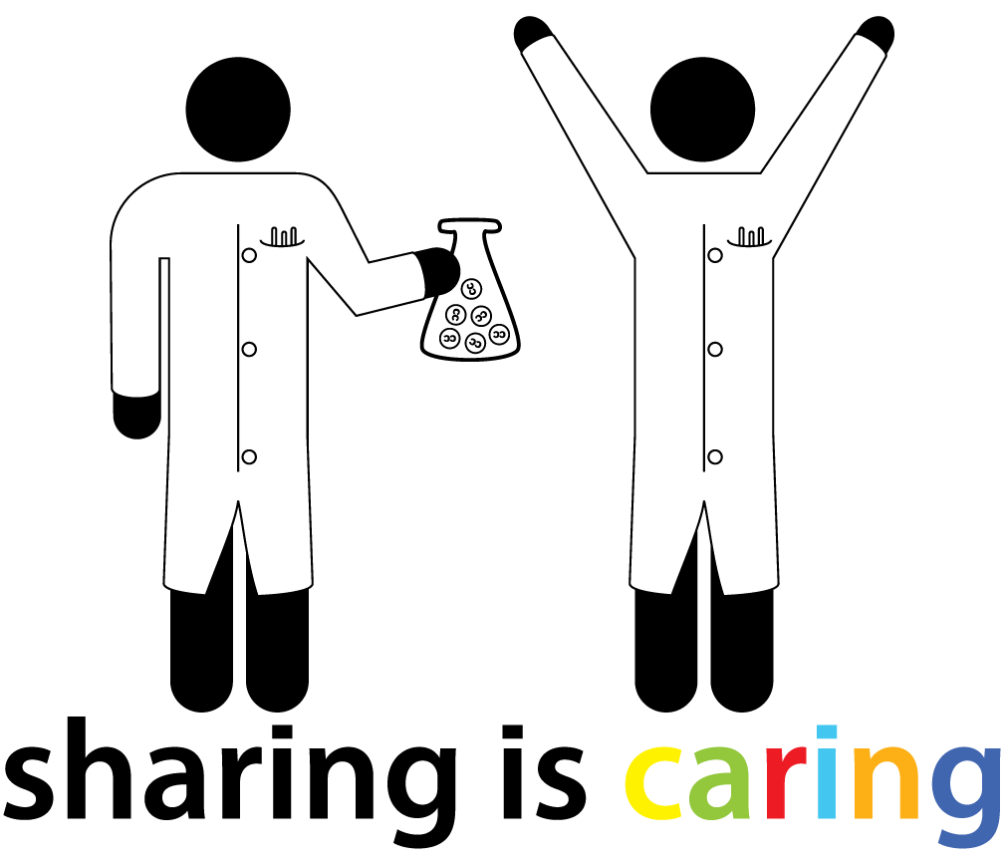

Thank you !
@BordeauxTea

